Slide 1
Automatic News Article Summarization System with Sentiment Analysis
Minor Project Presentation
Presented by: Ayush Shah – 219301533 Sarthak Pannu - 219301314
Under the guidance of: Dr. Sakshi Shringi
Notes:
In today's information age, staying informed can be a challenge due to the overwhelming amount of online news content. This presentation explores an automatic news article summarization system with sentiment analysis to address this challenge.

Slide 2


INTRODUCTION
Information overload is a growing problem in the digital age.
Users struggle to keep pace with the constant influx of news articles.
This can lead to user fatigue and decreased engagement with news platforms.
Notes:
The vast amount of information available online, particularly news articles, can be overwhelming. Users struggle to keep up with the constant flow of news, leading to frustration and disengagement. This system aims to help users stay informed by summarizing news articles and identifying their sentiment.

Slide 3
OBJECTIVES
Develop a system to identify key points in news articles using NLP techniques.
Generate concise and informative summaries capturing the essence of the article.
Integrate sentiment analysis to understand the emotional tone of the news (positive, negative, or neutral).
Leverage machine learning to optimize the summarization process.
Create a user-friendly system for seamless integration with news platforms.
Notes:
This project has several key objectives. It aims to develop a system that can accurately summarize news articles by identifying key points using Natural Language Processing (NLP) techniques. The system will also generate concise summaries that capture the essence of the article while remaining informative. Sentiment analysis will be integrated to understand the emotional tone of the news article, allowing users to develop a more nuanced understanding of the content. Machine learning will be leveraged to optimize the summarization process and ensure high-quality summaries. Finally, the system will be user-friendly and integrate seamlessly with existing news platforms

Slide 4
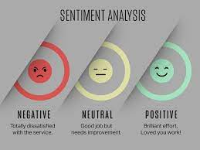
TWO FOLD APPROACH
Summarization: Identifies and extracts key information from the news article.
Extractive summarization: condenses the original text.
Abstractive summarization: paraphrases key information.
Sentiment Analysis: Analyzes the emotional tone of the article text (positive, negative, or neutral).
Provides insights into potential perspectives or biases within the news article.
Notes:
This system utilizes a two-fold approach: summarization and sentiment analysis. Summarization techniques can be extractive, condensing the original text, or abstractive, paraphrasing key information. Sentiment analysis analyzes the emotional tone of the news article text, classifying it as positive, negative, or neutral. This can reveal potential biases or perspectives within the news article, allowing users to develop a more comprehensive understanding of the content.

Slide 5
TECHNOLOGY USED
Hardware: Modern multi-core processor, sufficient RAM and storage.
Software: Python (version 3.6 or later), TextBlob for NLP tasks, Newspaper for article extraction (optional libraries: NLTK, visualization libraries).
Notes:
Developing this news article summarization system requires specific hardware and software components. The hardware includes a modern multi-core processor, sufficient RAM for program execution, and storage space for system software and potentially large datasets. The software primarily relies on Python as the development language. TextBlob offers pre-trained NLP models for text processing, sentiment analysis, and summarization. Newspaper is a specialized library for efficiently extracting news articles from websites. Optional libraries like NLTK and visualization libraries can be used for further customization or data analysis.

Slide 6
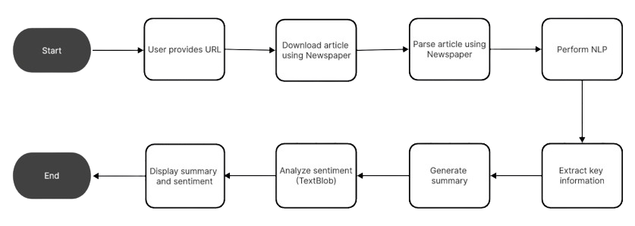
FLOWCHART
Notes:
User provides news article URL.
System downloads article content.
System extracts text from downloaded article.
(Optional) Perform additional NLP tasks (NLTK).
Extract key information from article text.
Generate concise and informative summary.
Analyze sentiment of article text (positive, negative, neutral).
Display summary and sentiment analysis to user.

Slide 7
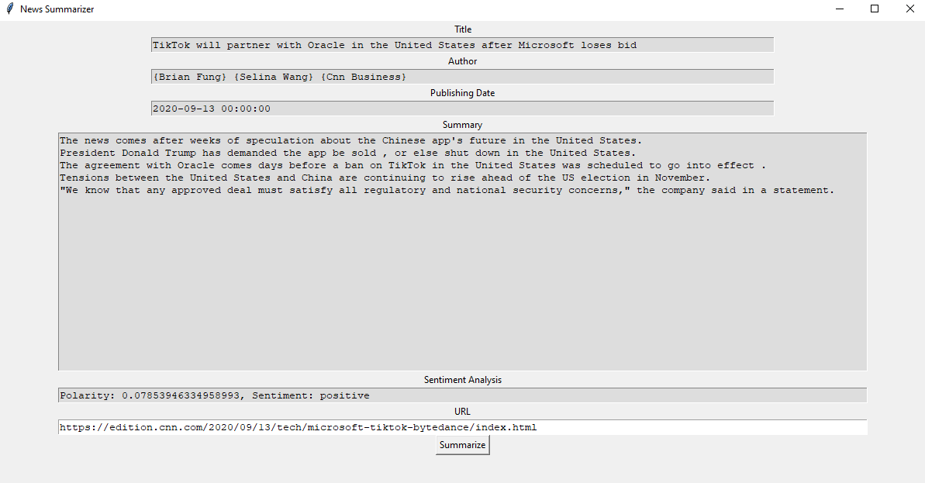
USER FRIENDLY INTERFACE
Tkinter for Easy Interaction: This project utilizes Tkinter to create a user-friendly Graphical User Interface (GUI).
Seamless User Experience: The GUI provides a clear and intuitive way to interact with the system.
Notes:
Key GUI Elements:
Input: A designated URL field allows users to easily paste or type the news article URL.
Clear Output:
Summary: A multi-line text box displays the automatically generated summary.
Sentiment Analysis: This section presents the emotional tone of the article (positive, negative, or neutral).
Optional Elements: The GUI might include additional fields to display the extracted title, author (if available), and publishing date (if available).

Slide 8
CHALLENGES
Limited Summarization Techniques: The project currently relies on basic summarization approaches offered by TextBlob. While functional, these may not capture the full nuance of complex articles.
Accuracy and Readability: Balancing the conciseness of summaries with the need to retain key information can be difficult. Additionally, ensuring summaries are grammatically sound and easy to read requires further refinement.
Multilingual Support: Currently, the system likely focuses on English language news articles. Expanding to other languages would require additional libraries or frameworks and potential adjustments to the summarization process.
Limited Personalization: The system doesn't currently consider user preferences. Tailoring summaries based on user interests or information needs could enhance the user experience.
Real-Time Processing: Integrating the system with live news feeds or social media streams for real-time summarization presents technical challenges.

Slide 9
IMPROVEMENTS
Advanced Summarization Techniques: Exploring abstractive summarization techniques could go beyond just condensing the text and involve paraphrasing key information for a more natural and informative summary.
Multilingual Capabilities: Incorporating libraries designed for multilingual NLP tasks would allow users to summarize and analyze articles in their native languages.
User Modeling and Personalization: Researching user modeling techniques can personalize summaries based on user interests and information needs, creating a more engaging experience.
Evaluation and Refinement: Developing metrics to evaluate the effectiveness of summarization and sentiment analysis can guide further improvements and optimization of the system.

Slide 10
FUTURE ADVANCEMENTS
Deeper Summaries:
Deep learning and attention mechanisms can create summaries that capture the essence and sentiment of the article even better.
Global Access:
Multilingual support will allow users to summarize and analyze news in their native languages.
Personalized Feeds:
Tailored summaries based on user interests can create a more engaging experience.
Real-Time Updates:
Summarization of live news feeds or social media streams keeps users informed without overload.
Fact-Checking Integration:
Combining summarization with fact-checking helps identify reliable sources and verify information.

Slide 11
CONCLUSION
Problem: Information Overload: The vast amount of online news content creates a challenge for users to stay informed, leading to frustration and disengagement.
Solution: Automatic Summarization with Sentiment Analysis : News summarization systems with sentiment analysis address this problem by generating concise summaries and identifying the emotional tone of articles.
Project Foundation This project provides a solid starting point for building such a system by utilizing libraries like TextBlob and Newspaper for text processing, sentiment analysis, and basic summarization.
Future Advancements : The project opens doors for further development.

Slide 12
Thanking You

